Slide 1


Slide 2
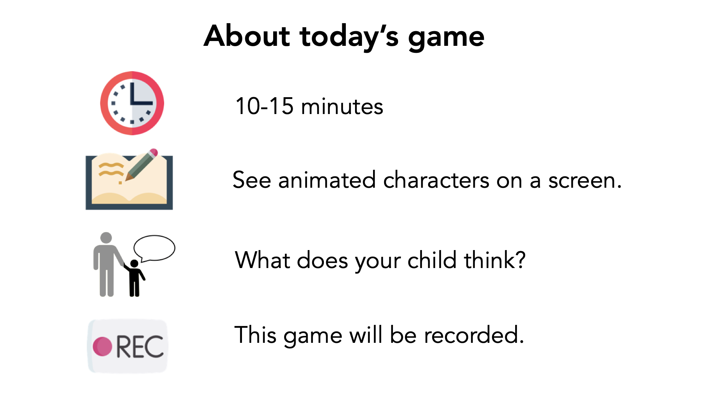

Slide 3
Verbal Consent
"I have read and understand the consent document. I am this child's parent or legal guardian and we both agree to participate in this study."

Slide 4


Slide 5
Notes:
First, we’re going to look at some shapes. [child name], I want you to imagine the two shapes in each box to be two people.
What colors are the boxes?
Warmup 1: Which shapes do you think are most like a mom and her baby?
Warmup 2: Which shapes do you think are most like two people who don’t know each other?
Warmup 3: Which shapes do you think are most like friends?

Slide 6
Sad Condition

Slide 7


Notes:
This is Percy! [click] I am going to tell you a story about him!
Percy feels sad today [click] and doesn’t know why

Slide 8
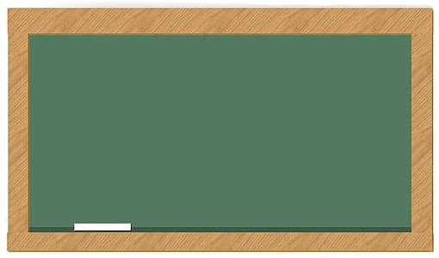


Notes:
In school today, Percy learned that foxes move without making any sound.

Slide 9
Notes:
But Percy is still feeling sad, even after he learned an interesting fact about foxes.

Slide 10



Notes:
While waiting to get on the bus after school, Percy saw a classmate named Avery. Avery said “Hi Percy! How was school today?”
Percy told Avery about how he learned foxes move without making sounds. [click 2x]

Slide 11

Notes:
Percy did not tell Avery that he was feeling sad today. [click 3x]

Slide 12

Notes:
Percy saw another classmate named Orin. Orin said “Hi Percy! How was school today?”
Percy did not tell Orin about how he learned foxes move without making sounds. [click 3x]

Slide 13
Notes:
But Percy did tell Orin that he was feeling sad today. [click 2x]

Slide 14

Notes:
Which classmate did Percy tell about foxes?

Slide 15
Notes:
Which classmate did Percy tell about feeling sad today?
[wait for and record the child’s response]
Okay thank you.

Slide 16
Notes:
which box do you think is most like Percy and Avery?
[wait for and record the child’s response]
Alright, thank you.

Slide 17
Notes:
which box do you think is most like Percy and Orin? Why?
[wait for and record the child’s response]
Alright, thank you.

Slide 18
Who do you think is a better friend?
Notes:
Who do you think is a better friend to Percy Why?

Slide 19

Notes:
Who do you think Percy would want to share an ice cream cone with? Why?

Slide 20

Notes:
Who do you think Percy would want to share candy with?Why?

Slide 21



Notes:
Later that day, Percy went to the playground and met someone who he wanted to be friends with. Do you think Percy should tell them about the foxes or that he is feeling sad today? Why?
[click 2x]

Slide 22

Notes:
After the playground, Percy saw his mom in the park! Percy’s mom said “Hey Percy how was school today?” Do you think Percy should tell his mom about the foxes or about feeling sad today?

Slide 23

Notes:
Then Percy saw his friend’s mom and she said “Hey Percy! How was school today?” Do you think Percy should tell her about the foxes or that he’s feeling sad?

Slide 24
Happy Condition

Slide 25

Notes:
This is Kendall! [click] I am going to tell you a story about him! Kendall feels happy today [click]

Slide 26
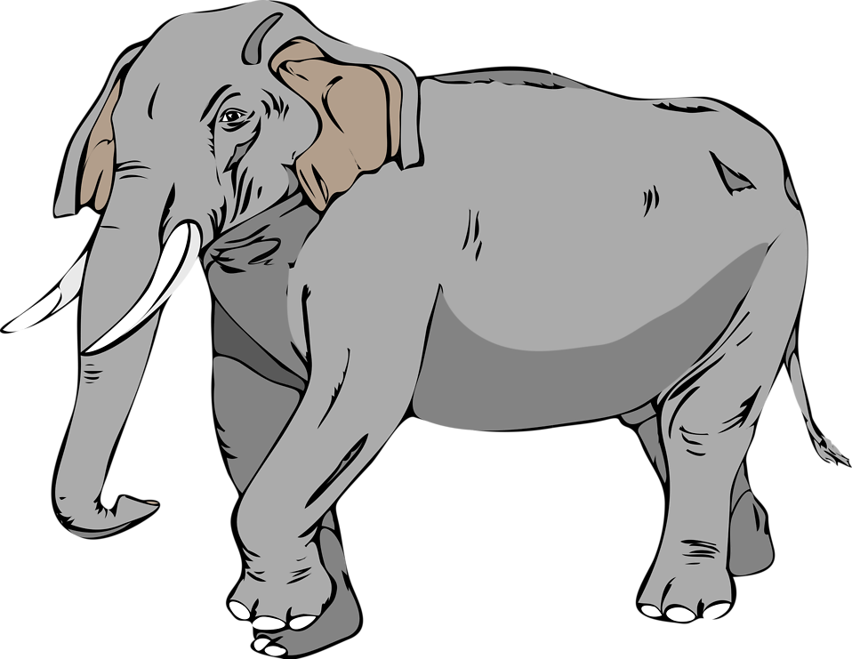
Notes:
In school today, Kendall learned that elephants move mostly in the morning.

Slide 27
Notes:
And Kendall is still feeling happy today, even after learning an interesting fact about elephants.

Slide 28


Notes:
On the way home, Kendall saw a classmate named Riley. Riley said “Hey Kendall! How was school today?”
Kendall told Riley about he learned that elephants move mostly in the morning. [click 2x]

Slide 29

Notes:
Kendall did not tell Riley that he was feeling happy today. [click 3x]

Slide 30

Notes:
Kendall saw another classmate named Cameron. Cameron said “Hey Kendall! How was school today?”
Kendall did not tell Cameron about how he learned that elephants move mostly in the morning. [click 2x]

Slide 31
Notes:
Kendall did tell Cameron that he is feeling happy today. [click 2x]

Slide 32
Notes:
Which classmate did Kendall tell about elephants?

Slide 33
Notes:
Which classmate did Kendall tell about feeling happy?

Slide 34
Notes:
which box do you think is most like Kendall and Riley?
[wait for and record the child’s response]
Alright, thank you.

Slide 35
Notes:
which box do you think is most like Kendall and Cameron?
[wait for and record the child’s response]
Alright, thank you.

Slide 36
Who do you think is a better friend?
Notes:
Who do you think is a better friend to Kendall? Why?

Slide 37
Notes:
Who do you think Kendall would want to share an ice cream cone with? Why?

Slide 38
Notes:
Who do you think Kendall would want to share candy with? Why?

Slide 39

Notes:
Later that day, Kendall went to the playground and met someone who he wanted to be friends with. Do you think Kendall should tell them about the elephants or that he is feeling happy today? Why?
[click 2x]

Slide 40
Notes:
After the playground, Kendall saw his mom in the park! Kendall’s mom said “Hey Kendall how was school today?” Do you think Kendall should tell his mom about the elephants or about feeling happy today?

Slide 41

Notes:
Then Kendall saw his friend’s mom and she said “Hey Kendall! How was school today?” Do you think Kendall should tell her about the elephants or that he’s feeling happy today?

Slide 42


Slide 43
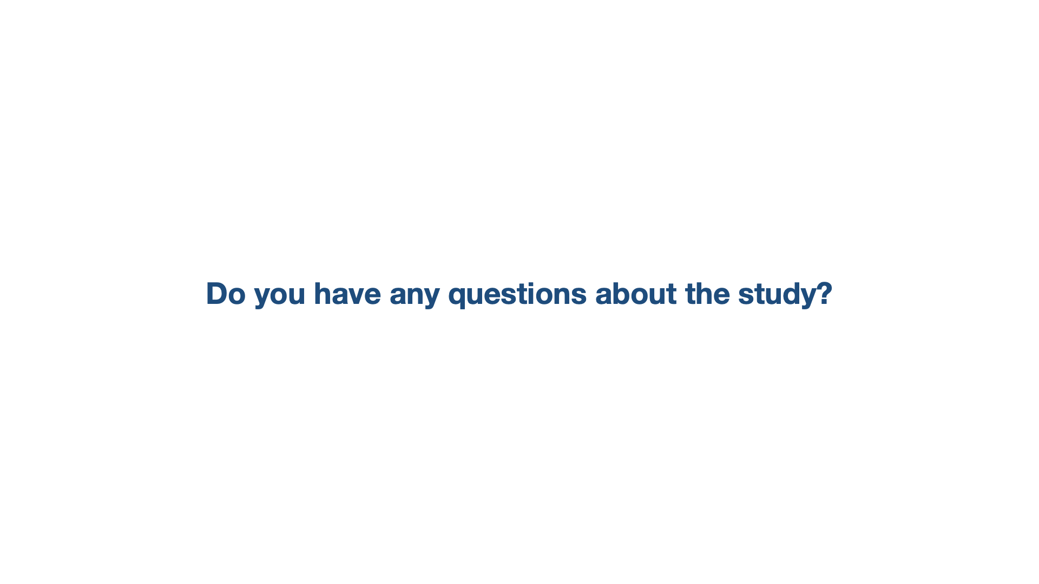

Slide 44
